Slide 1
Safeguarding Digital Operations in the era of AI
Kevin Forshaw
Director of Industrial & Strategic Partnerships
Chair of Maritime UK South West
Notes:
Autonomous navigation technology
Environmental impact
Simulation
Piracy
Cyber security
Impact on maritime workforce and human factors
Research projects
Remote satellite communications

Slide 2
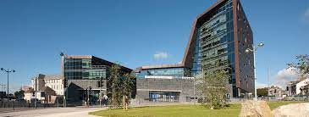
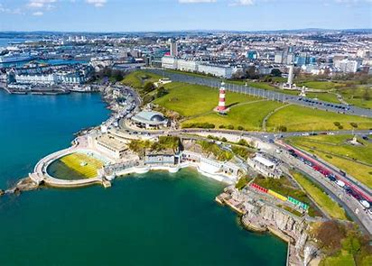
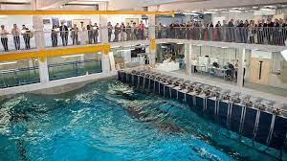
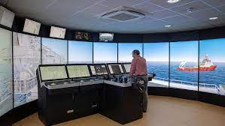
The University of Plymouth
The first and largest Marine Institute in UK, with over 3000 staff and students looking at the Ocean
Three-time winner of the Queen's Anniversary Prize for Higher and Further Education, UK Top 25 for Teaching Quality & World Top 25 for Research Citations
We lead in Marine Science (1st in the world for research towards SDG 14 2021), have the COAST Wave Basin, Navigation Simulation Lab, and extensive fleet of Marine Autonomous Systems
We apply these facilities to create the thought leadership for a future of safe, efficient and sustainable maritime operations

Slide 3
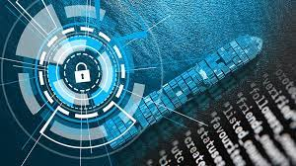
Embracing the advantages of Digitisation while managing the risk
Headline Issue
68% increase in Maritime Cyber-Attacks in 2021 (US Coast Guard)
Average cost to operators $180k rising to $1.8m mitigation cost for the top 8% of attacks (Great Disconnect Report)
Shipping is a very soft target
Platforms operating for 25 years + with legacy systems, and many additions to a network that no one really accepts exists!
Largescale ignorance throughout the sector
Current focus on IT, while completely forgetting the Operational Technology

Slide 4
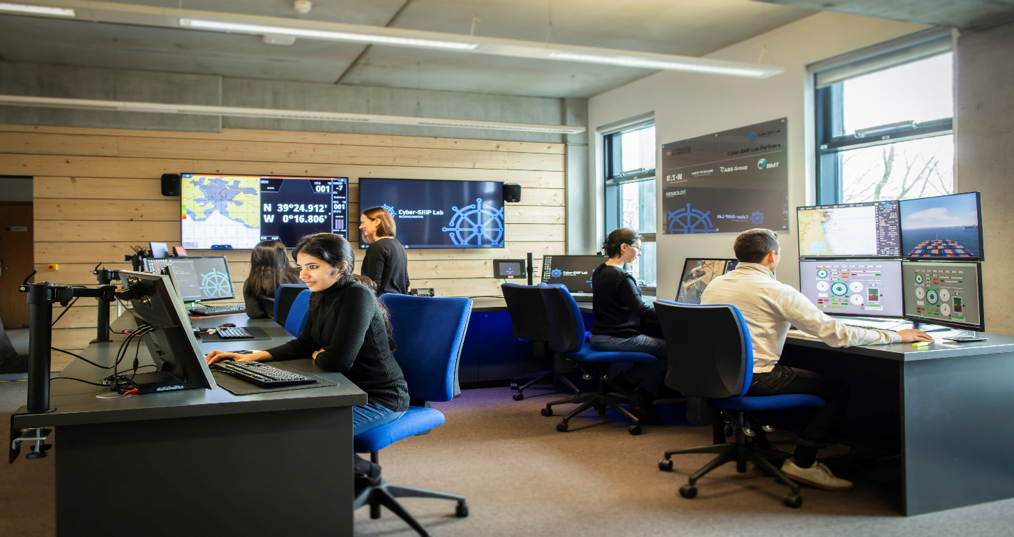
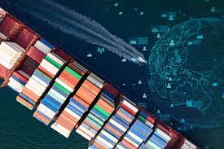
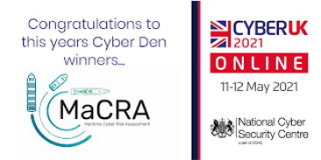
Resilience for the Sector
Sectors need genuine insight into system-level vulnerabilities
The Cyber-SHIP Lab at Plymouth is a reconfigurable, equipment test-bed
So real ship’s critical systems, configured to represent the vessel in question, subjected to audit suite of cyber-attacks
Sector also needs to shift to holistic appraisal of risk, in context of their specific operation
Our spin-out; Riskocity® is applying award-winning patented MaCRA® tooling that takes system-level vulnerabilities, cross-referenced with the threat actors associated with your operation (cargo and route)
Distilling complexity down to what operators need to act upon to safeguard their operation

Slide 5
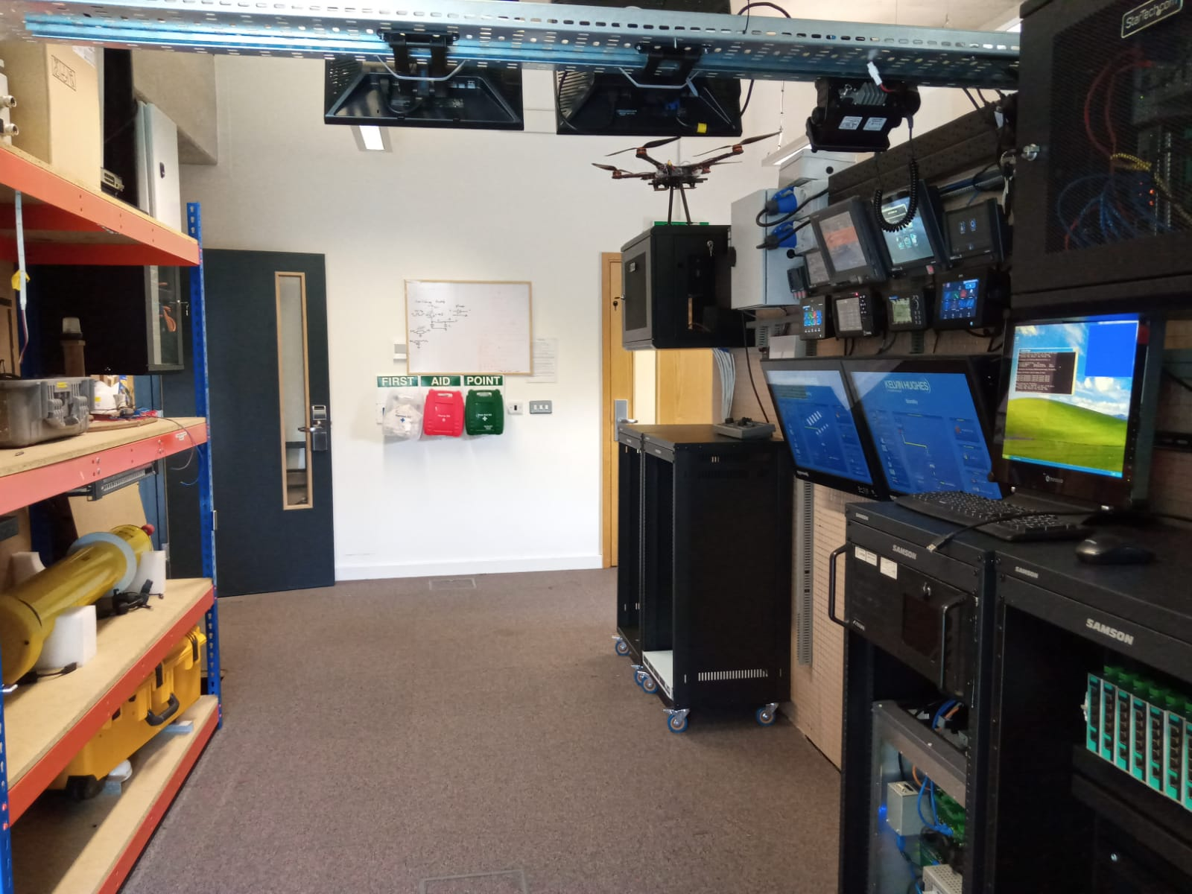
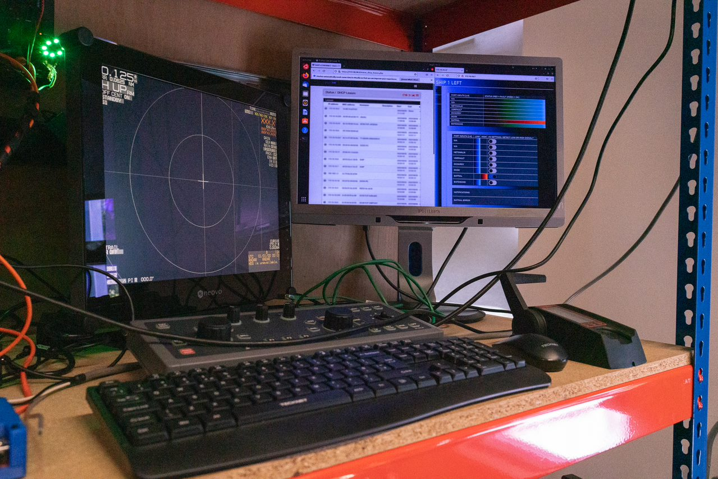
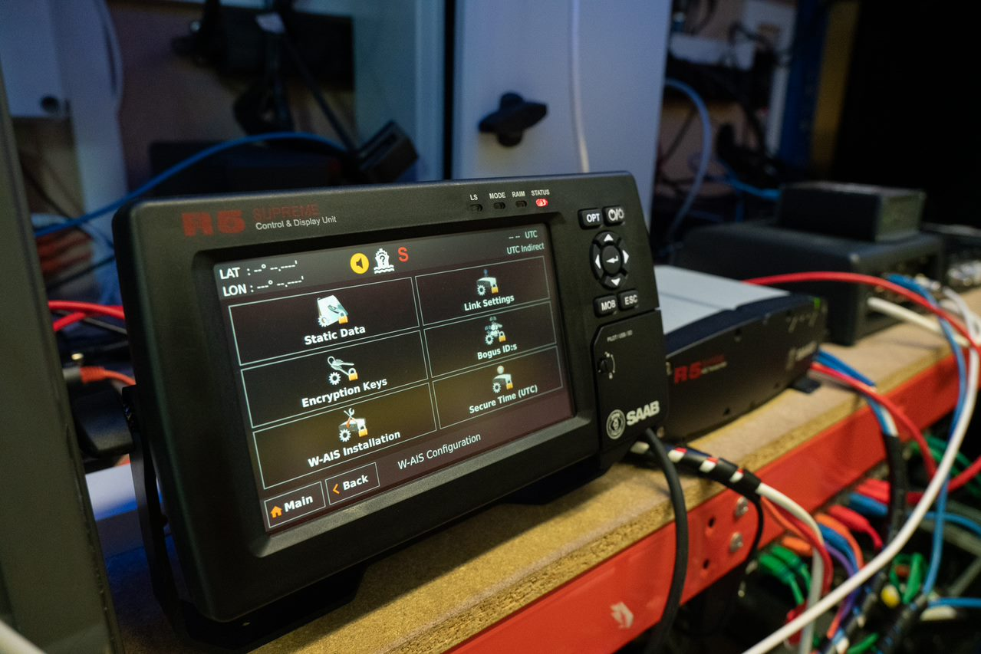
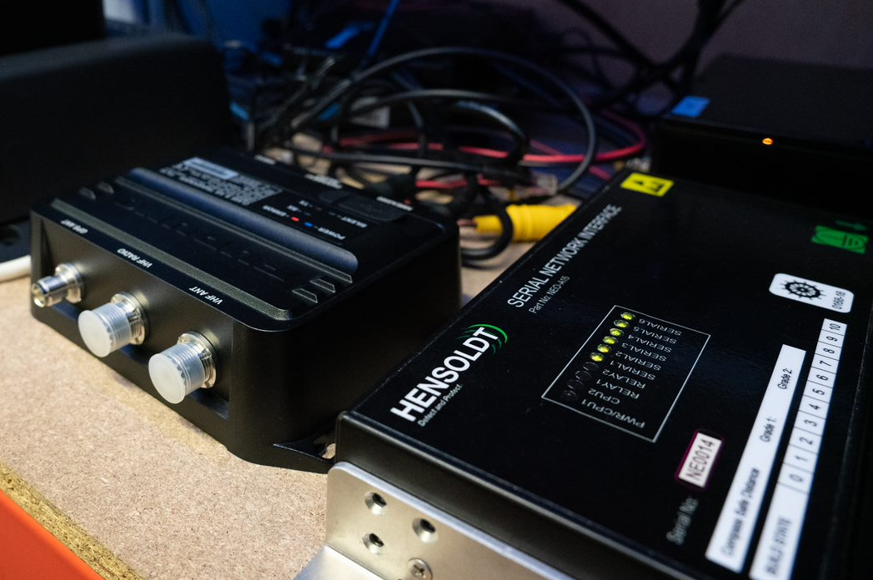
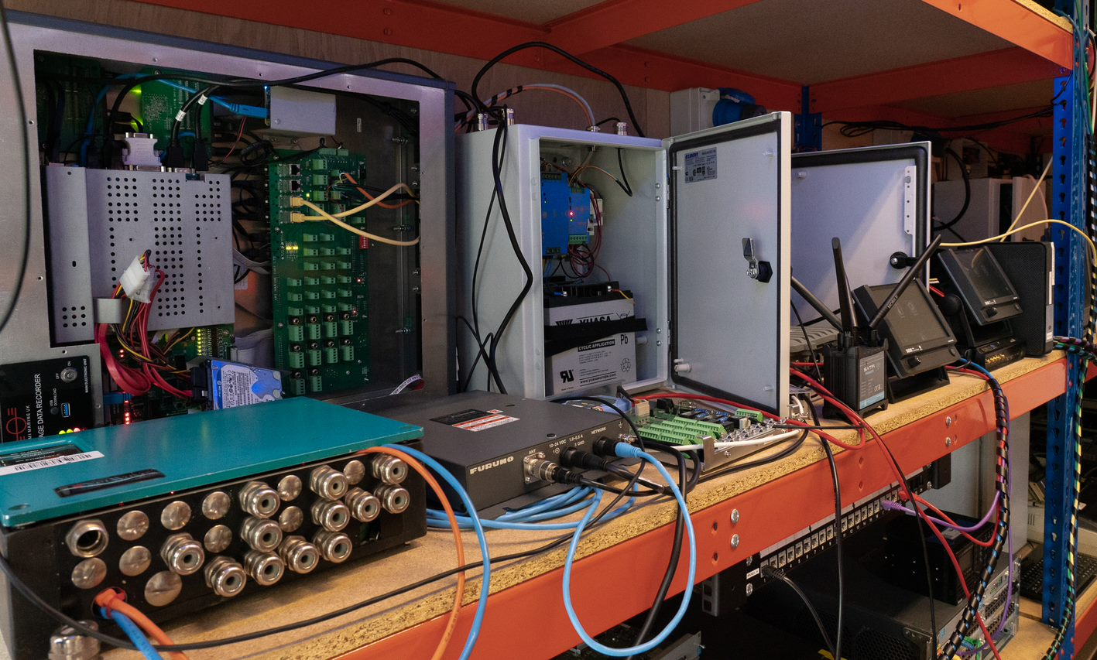
Cyber-SHIP Lab a £3.2m investment for the maritime sector
£3.2m investment

Slide 6
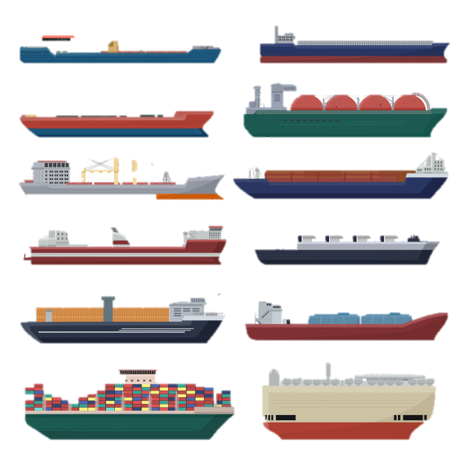
Cyber-SHIP Lab research aims
Harden systems from tampering
Collect forensics to detect attacks
Use data to create AI-based intrusion tools
Holistic understanding of connected systems-of-systems (OT and IT)
Examine security across hardware, software and people
With application to:
Shipping – crewed and autonomous
Smart ports / smart port cities
Internet-of-things; BYO-device
Ship-to-shore and ship-to-ship interactions
Notes:
Start of KT section

Slide 7
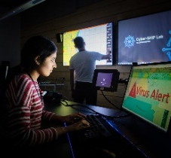
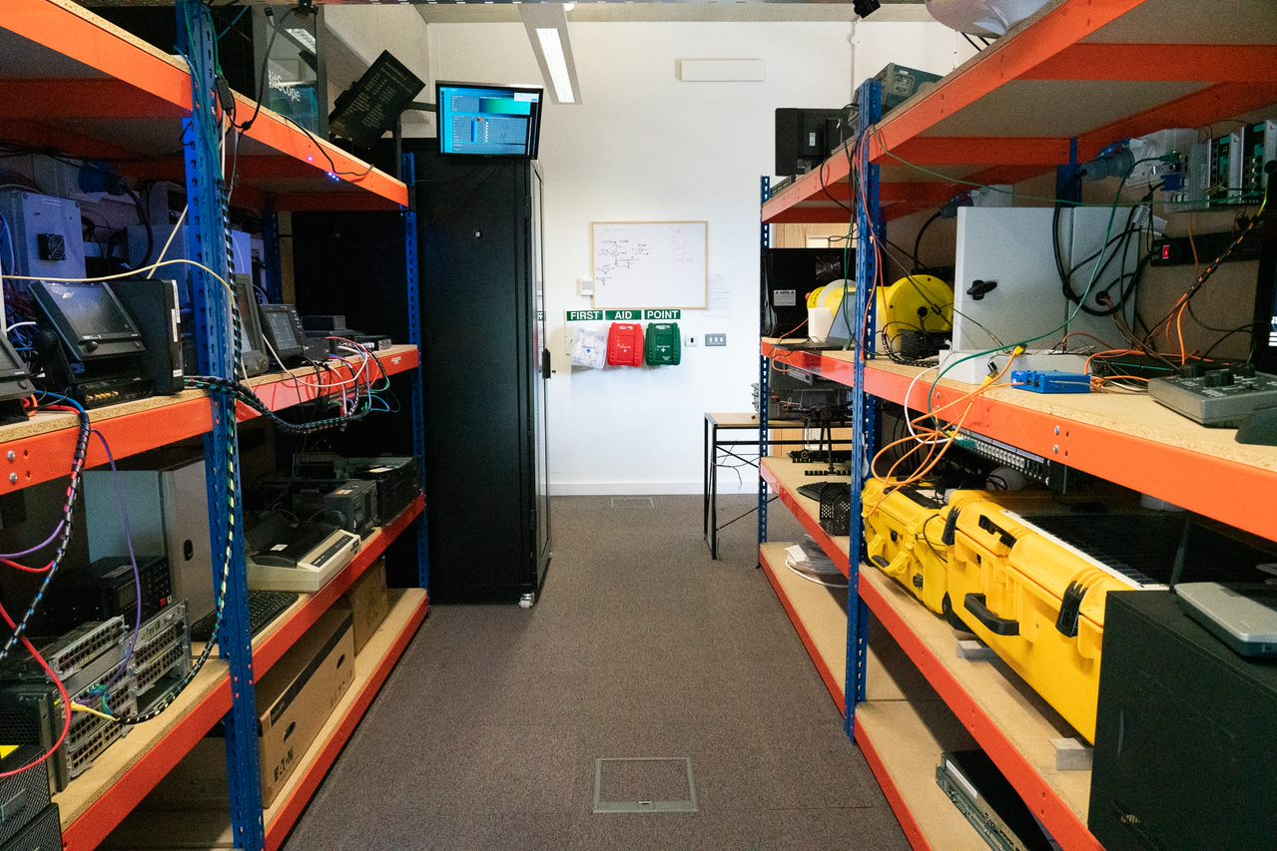
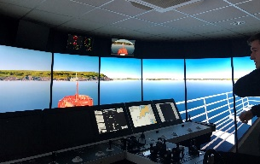
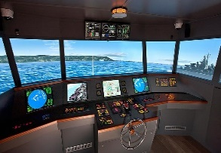
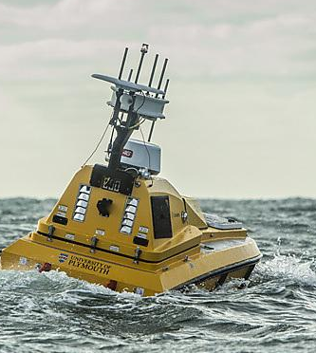
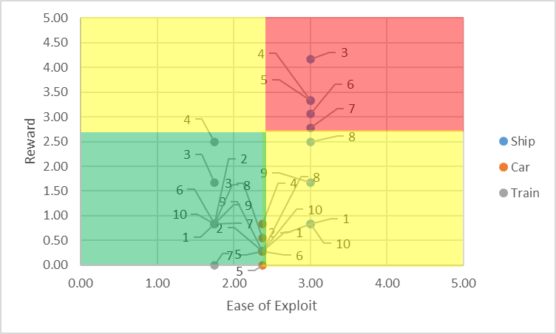
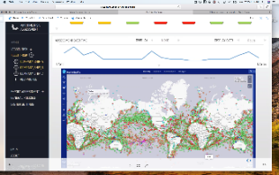
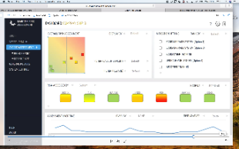
The wider Plymouth “ecosystem”
Shipping operators (civil and defence), equipment manufacturers, regulators, insurers
Visualisation and Simulation
Cyber-range labs
Cyber-SHIP Lab
Maritime Simulation Lab
Ship simulators
Visualisation



Exploits
Tools
Database
Data
Scenarios
Scenarios
Training
Training
Inform
Autonomous/
Remote control
Riskocity: Risk Assessment
MAS
Offshore Renewables
Smart Sound
Drones
Profiles
Reports
Shipping operators (civil and defence), equipment manufacturers, regulators, insurers

Slide 8
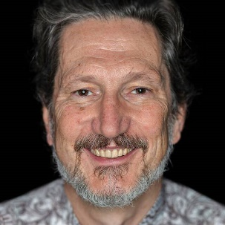
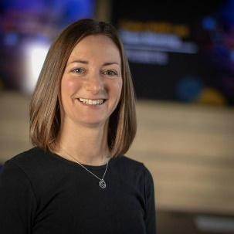
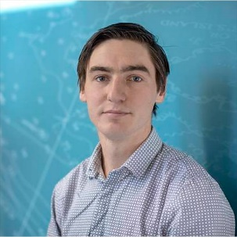
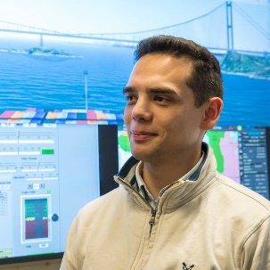
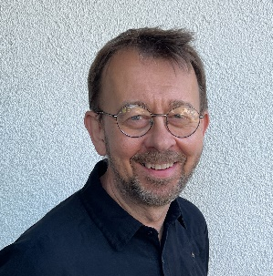
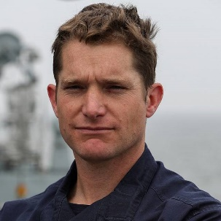
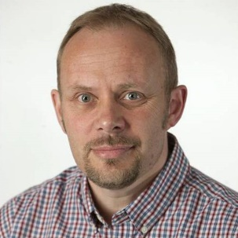
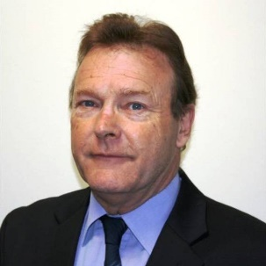
Cyber-SHIP Core Team
Cyber risk experts
Software and hardware design
Penetration testing
Electronic/Electrical engineering
Navigation and Watchkeeping
History
Policy and governance
Visualization
Law
Economics
Artificial Intelligence (AI) / Machine Learning (ML)
Wider Team

Slide 9
Thank you for listening:
Kevin Forshaw
Director of Industrial & Strategic Partnerships
Faculty of Science & Engineering
Kevin.forshaw@plymouth.ac.uk
Chloe Rowland
Cyber-SHIP Lab Project and Knowledge Exchange Manager
chloe.rowland@plymouth.ac.uk

